Slide 1
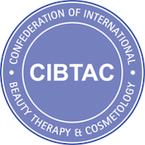
The CIBTAC / SALLY DURANT Partnership
Level 4 Qualifications in
Advanced Skin Studies and Aesthetic Practice

Slide 3
Meet the Team

Slide 4
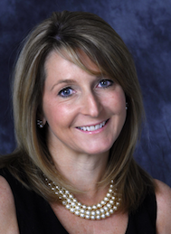
Who is Sally Durant?
Member of the JCCP Working Party for Education, Training and Accreditation
Member of the Aesthetic Practitioners Steering Group – HABIA
International CIBTAC Examiner
Member of the CIBTAC Education Team
Managing Director and Principal of the Sally Durant Training Consultancy
Notes:
Having graduated from Champneys College in 1982 Sally has dedicated her career to the development and maintenance of the highest standards of education and training within the beauty therapy industry. Her extensive experience in the management of skin health and non-medical aesthetics, together with a strong commitment to establish accredited qualifications for the medispa sector , Sally has pioneered the development of advanced post graduate training programmes for all skin care therapists and clinical practitioners.
She has combined her specialist knowledge of skin science, cosmetic dermatology and remedial skin treatment with 28 years experience in formal education and training to develop a unique series of first to market Level 4 Qualifications in Advanced Skin Studies and Aesthetic Practice which are accredited in partnership with CIBTAC. These courses are specifically designed on a flexible blended learning format to ensure that all therapists can access this vital professional development in preparation for registration and the changes taking place to regulate the aesthetics sector.
As an active member of the JCCP Working Party for Education Training and Accreditation and sits on the Aesthetic Practitioner Steering Group chaired by HABIA Sally has represented and supported the beauty therapy industry with a steadfast commitment to establishing its position and respect within the aesthetics sector. Most recently she has led the development of the new qualification standards for skin rejuvenation treatments at Levels 4 – 6 and continues to push for improved training opportunities for aesthetic therapists in the UK and around the world.

Slide 5
The World of
Aesthetic Practice

Slide 6
What is Aesthetics?
What is aesthetics?
Notes:
But what is the actual meaning of the word aesthetics ?. If you look it up in the dictionary it will tell you that aesthetic scan be a term relating to anything to do with outward appearance but not just of the face or body. Aesthetics is a term used in all forms of art, and design in relation to something being aesthetically pleasing to the eye.. In terms of today’s beauty industry it means results-driven clinical treatment of the skin or body performed by multi-discipline professionals including doctors and nurses, dermatologists, plastic surgeons and advanced beauty therapists or aesthetic therapists as they have become known.

Slide 7
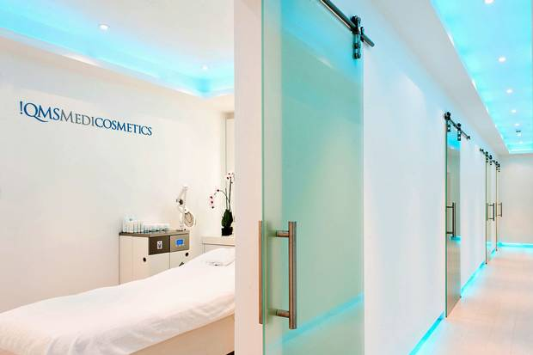
The Birth of the Medispa
Notes:
Putting all the professional aesthetic disciplines together has created the concept of the medispa. This really represents the future of the industry and embraces the combination of clinical excellence and health care with the luxury of spa, the comfort of therapy and the impact of cosmetic enhancement. For a while it was considered that each of these areas of specialisms could never be combined with integrity and safety but indeed they do compliment one another immensely, as long as their integration with one another is achieved within the correct protocol. In this way medical and non-medical practitioners can work in harmony to provide the very best in skin and body care that takes into account the ‘whole’ health of the individual and addresses each individual’s needs within a very rounded, inclusive and vibrant business model.
With the MDT and medispa environment in mind, we will now explore the most prominent aesthetic treatment modalities, their technologies, indications for use their effects and benefits. Will also indicate who can perform these treatments under the UK qualification standards but, if you are studying outside the UK, you will need to check with your own government guidelines and insurance cover parameters.

Slide 8
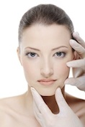
What can the Aesthetic Therapist offer their clients?
REAL RESULTS Driven by :
Exceptional understanding and knowledge
Superior skin assessment skills
Specialist understanding of cosmetic dermatology
The most up to date clinical treatments
Effective remedial treatment programmes
Ongoing skin health management
Cosmeceutical skin care

Slide 9
The Global Aesthetics Market
By 2018 the global growth of the aesthetic industry is set to reach £5.9 billion, €6.6 billion and $ 7.3 million
*Source: The Statistics Portal 2014
Notes:
Furthermore this rapid development of the global industry is estimated to to reach 5.9 billion British pounds by 2018 which is equivalent to 6.6 billion euros and 7.3 billion US dollars

Slide 10
Rapid Industry Growth
The UK Aesthetics industry was estimated to be worth £3.5 billion
by the end of 2015
Notes:
If we consider the UK market alone the aesthetics industry was estimated to be worth £3.5 billion at the end of 2015. If you are studying outside the UK you may like to research the sector value in your own country.

Slide 11
Career Progression
Career Progression
Notes:
Suffice to say this remarkable market growth represents a huge career opportunity for everyone working, or wanting to work with the medispa clinic environment.. The employment opportunities now presenting themselves reflect the greater diversity of job roles for aesthetic doctors, nurses and dentists wishing to develop a cosmetic dermatology specialism and for beauty therapists looking to take their careers to a more advanced level. Additionally individuals from other health care related disciplines such as pharmacists, radiologists, physiotherapists and podiatrists are also finding that the have something to contribute within the aesthetic clinic. Jobs in this sector will range from clinical practice itself through to, business development, clinic management, marketing, field sales, education and training and , for most, these roles represent a higher than average rate of earnings.

Slide 12
Business Growth
Notes:
Having established that the employment market for individuals working within the medispa sector represents an exciting career development pathway, moving into the realms of the medispa is an equally lucrative proposition for those running businesses in the more traditional health, beauty and spa sector. Treatment procedure prices are pitched at a much higher level level than standard beauty therapy procedures with little or no increase in the time and cost incurred by their delivery– indeed many of these treatments are very low cost and extremely time efficient. Thus a superior profit margin can be established while at the same time a business will differentiate itself from its competitors. Incorporating aesthetic practices into any skin care business can provide a real point of difference and establish a reputation for being a specialist in your field.

Slide 13
The Industry Void
Technology & Demand
Education & Training
Notes:
With all this industry growth it is surprising that up until 3 years ago there were no formal ly accredited qualifications in treatments such as chemical skin peeling , micro-needling and advanced skin studies required to underpin such advanced treatments

Slide 14
Aligned to New National Occupational Standards
Notes:
In supporting the Keogh review recommendations, it is not HEE’s intention to exclude any practitioners from delivering
cosmetic procedures or to deny training to any industry sectors, as this might encourage practitioners to practise without
training or with training which does not meet the standards recommended by HEE which could consequently undermine
patient safety. Rather than seeking to exclude practitioners who do not have clinical training, Keogh sought to address
the patient safety aspect by requiring professional/clinical oversight of nonhealthcare practitioners for some more
complex procedures, and this is the approach underlying these qualification requirements.

Slide 15
Sally Durant
Member of the JCCP Working Party for Education, Training and Accreditation
Member of the Clinical Practice Standards Consultation Group
Member of the Aesthetic Practitioners Steering Group - HABIA
Managing Director and Principal of the Sally Durant Training Consultancy

Slide 16
Our Level 4 Course Portfolio

Slide 17
The CIBTAC / SALLY DURANT Partnership
A complete portfolio of advanced learning and practical training programme designed for the clinical skin therapist and medical aesthetic practitioner working in skin health management and remedial skin treatment.
Notes:
In supporting the Keogh review recommendations, it is not HEE’s intention to exclude any practitioners from delivering
cosmetic procedures or to deny training to any industry sectors, as this might encourage practitioners to practise without
training or with training which does not meet the standards recommended by HEE which could consequently undermine
patient safety. Rather than seeking to exclude practitioners who do not have clinical training, Keogh sought to address
the patient safety aspect by requiring professional/clinical oversight of nonhealthcare practitioners for some more
complex procedures, and this is the approach underlying these qualification requirements.

Slide 18
Our Unique Provision
Our Level 4 courses incorporate an unprecedented level of study in skin science, skin health management, cosmetic dermatology and remedial skin treatment.
They are the first courses of their kind to be accredited by Qfqual and are fully aligned to the new national curriculum standards

Slide 19
All Sally Durant Level 4 courses are Ofqual regulated and accredited by the international awarding body CIBTAC

Slide 20
Ofqual Accreditation
In line with Ofqual guidelines, our qualifications are categorised as Awards, Certificates or Diplomas
Awards = 1 – 12 Education Credits ( 10 – 120 hours)
Certificates = 12 – 37 Education Credits (120 – 370 hours)
Diplomas = 38 + Education Credits ( 380 + hours)

Slide 21
Level 4 Awards
The Level 4 Award in Core Knowledge for Aesthetic Practice
The Level 4 Award in Advanced Skin Science
The Level 4 Award in Skin Health Assessment for Aesthetic Practice

Slide 22
Level 4 Certificates
The Level 4 Certificate in Advanced Skin Studies and the Principles of Aesthetic Practice
The Level 4 Certificate in Chemical Skin Peeling
The Level 4 Certificate in Micro-Needling
The Level 4 Certificate in Non-Surgical Blemish Removal

Slide 23
Level 4 Diplomas
The Level 4 Diploma in Chemical Skin Peeling and Micro-Needling
The Level 4 Diploma in Aesthetic Practice
The Level 4 Diploma in Advanced Skin Studies, Chemical Skin Peeling and Micro-Needling

Slide 24
Building Your Qualfication
The Sally Durant L4 courses are made up units of study according to what the students wants to learn.
This modular approach provides you with the opportunity to tailor your training to your needs, available time and budget

Slide 25
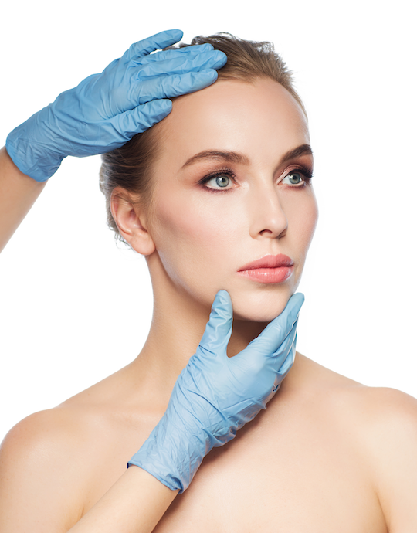
A Unit Based Approach
Unit 1 - Core of Knowledge
Unit 2 - Advanced Skin Science
Unit 3 - Investigative Consultation and Advanced Skin Assessment
Unit 4 - Chemical Skin Peeling

Slide 26
A Unit Based Approach
Unit 5 - Micro-Needling
Unit 6 - Blemish Removal ( Short
Wave Diathermy and
Cryotherapy)
Unit 7 - The Principles and Practices
of the Medispa Sector

Slide 27
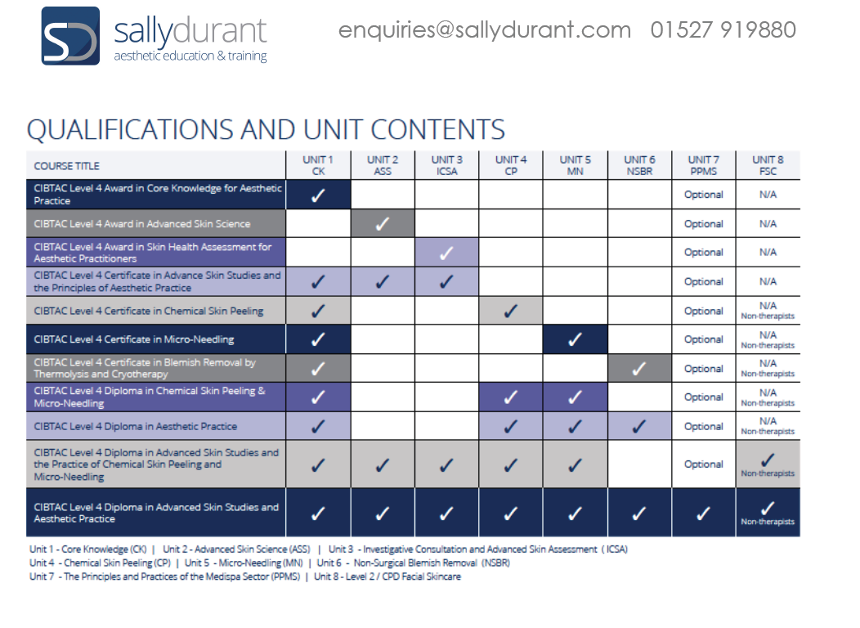

Slide 28
Designed to be …..

Slide 29
Our Level 4 Course Portfolio

Slide 30
Your Student Handbook

Slide 31
Your Course Tutor

Slide 32
Your Course Tutor will ….
Support, motivate and mentor you throughout your course
Answer any questions you may have
Provide learning support for any elements of the course you may find difficult
Liaise within you on the completion of your course and assessment schedule

Slide 33
Your Course Tutor will …..
Marking your written assessments, assignments and case studies where applicable
Arrange your attendance for practical training where applicable
Assist you in the compilation of your Course Portfolio

Slide 34
Your Course tutor will….
Complete your Induction Complete your Learning Agreement with you
Liaise with you on your Course Completion Schedule
Arrange monthly tutorial appointments with you

Slide 35
Your Course Tutor will….
Book your practical training days
Book your Formative Assessment Days
Book your mock examinations
Book your final CIBTAC / SALLY DURANT exams

Slide 36
Your Learning Agreement

Slide 37
The Unit Based and Modular Format

Slide 38
Your Course Completion Schedule

Slide 39
The Student Zone on
www.sallydurant.com

Slide 40
Your Course Folders

Slide 41
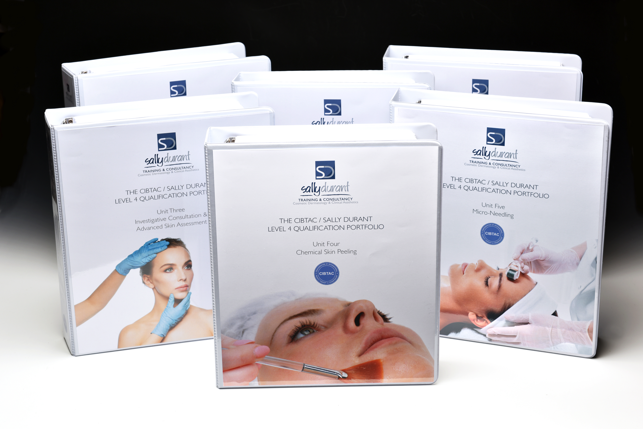
Hard Copy Resources
Notes:
In supporting the Keogh review recommendations, it is not HEE’s intention to exclude any practitioners from delivering
cosmetic procedures or to deny training to any industry sectors, as this might encourage practitioners to practise without
training or with training which does not meet the standards recommended by HEE which could consequently undermine
patient safety. Rather than seeking to exclude practitioners who do not have clinical training, Keogh sought to address
the patient safety aspect by requiring professional/clinical oversight of nonhealthcare practitioners for some more
complex procedures, and this is the approach underlying these qualification requirements.

Slide 42
Your Sally Durant
Memory Stick

Slide 43
Your E-Learning Programme

Slide 44
Interactive / Audio-Visual Delivery

Slide 45
How to Access Your
E-Learning Presentations

Slide 46
Internet Bandwidth

Slide 47
IT Support

Slide 48
Completing Your E-Learning

Slide 49
Booking your Practical Training

Slide 50
Attending Your Practical Training

Slide 51
Treatment Models

Slide 52
Your Assessment, Assignment and Examination Schedules

Slide 53
How to Submit your Courswork

Slide 54
Your Activity Logs

Slide 55
Building Your Portfolio

Slide 56
Your Final CIBTAC Exams

Slide 57
Useful Contact Information

Slide 58
Sally Durant Policies

